Slide 1

Health Insurance Cost Prediction Using Regression Models Master of Science(statistics) SCHOOL OF STATISTICS DEVI AHILYA VISHVAVIDYALAYA, INDORE
Under the supervision of
Submitted by:
Dr. SNIGDHA BANERJEE
MUSKAN THAKUR
Head of a Department
M.Sc. 4th semester
DATE: 2023/5/23

Slide 2

Introduction
Health insurance plays a crucial role in safeguarding individuals, families, and organizations from the financial burdens caused by unforeseen medical events and escalating healthcare costs. With the advent of advanced technologies and the vast availability of data, insurance companies are exploring new avenues to improve their operations and services. This presentation delves into the application of Machine Learning (ML) algorithms in the health insurance sector to enhance the prediction of insurance charges and improve decision-making processes.

Slide 3

Primary goals
Using Multiple Linear Regression - a machine learning technique - I try to determine the most (statistically) significant factors (independent variables) that influence the premiums charged (dependent variable) by an insurance company. I predicted the costs based on the insurance data that I obtained from worlddata.ai.

Slide 4
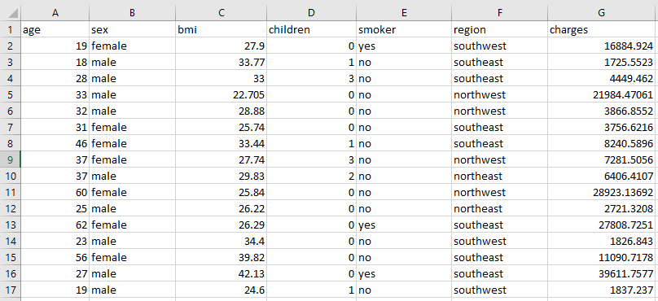
Dataset

Slide 5
The attributes in the following table:
Name | Description
Age | Customer’s Age
BMI | Body mass index of the customer
Number of kids | Number of kids of the customer
Gender | Male / Female
Smoker | Whether the customer is smoker or not
Region | Where the customer lives: southwest, southeast, northeast, northwest
Charges (target variable) | Medical fee the customer has to pay

Slide 6
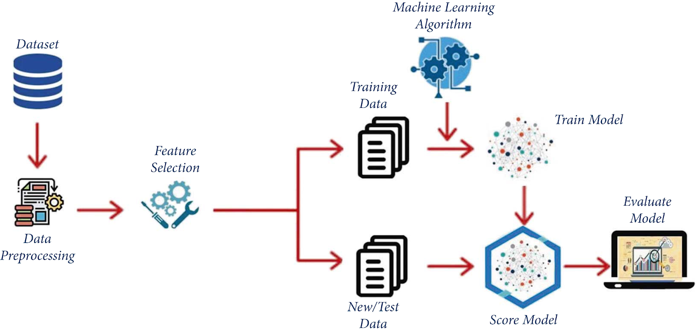
METHODOLOGY

Slide 7
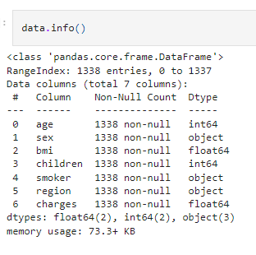
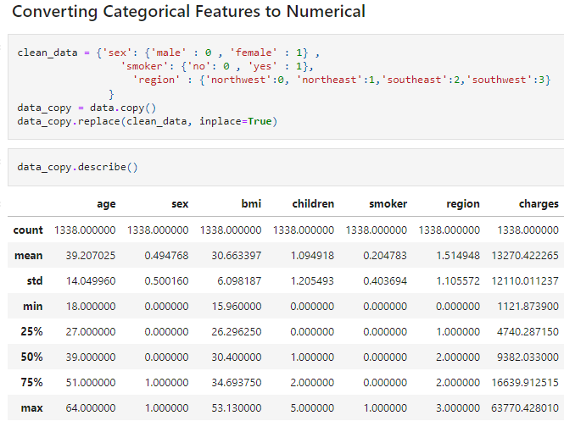
Pre-processing Data set
There are no missing values as such, so that we will calculate region, children value and sort them.
After that we convert features to numerical value.

Slide 8
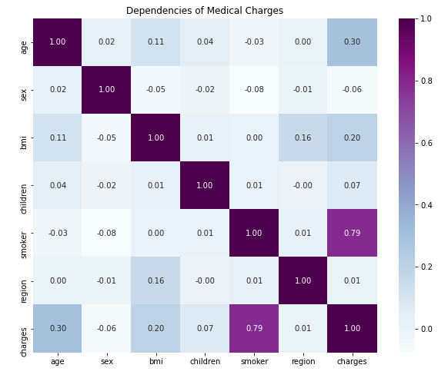
Correlation Matrix
Smoker, BMI and Age are most important factor that determines - Charges

Slide 9
Now we are confirmed that there are no other values in above pre-processing column, We can proceed with EDA

Slide 10
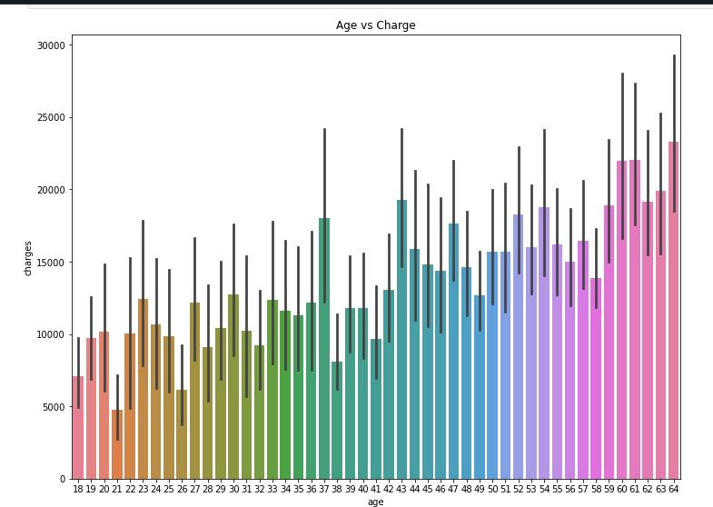
Age vs. Charges
The insurance charges are going to be increased. For example, when the age touches 64, the insurance charge is 23000

Slide 11
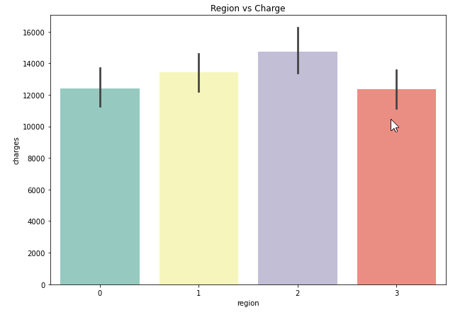
Region vs. Charges
The health insurance charges in the southeast are greater than in other regions.

Slide 12
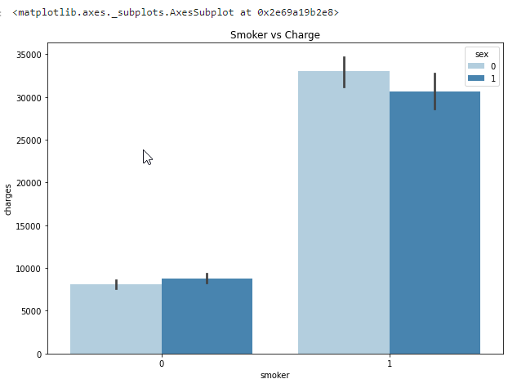
Smoker vs. Charges
The zero value is used to represent the females and one value is used for the males. The BMI values of sex or gender types (male and female) are given in the x-axis, and the charges are presented in the y-axis. It can be clearly seen that when the values of BMI are varied, the insurance charges will vary accordingly as shown in Figure .

Slide 13
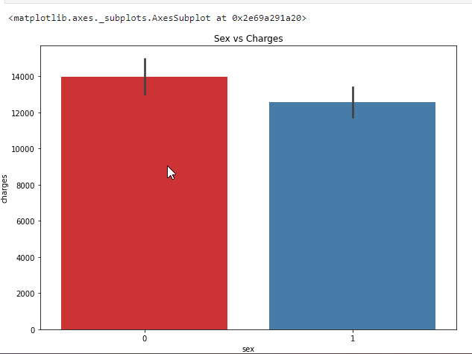
Sex vs. Charges
The medical insurance charges for the female gender are always greater than for the male as shown in Figure . It gives the sex types on the x-axis and the charges on the y-axis. The figure illustrates that the insurance charges for the female are 14000, and for the male, the charges are around 13000.

Slide 14
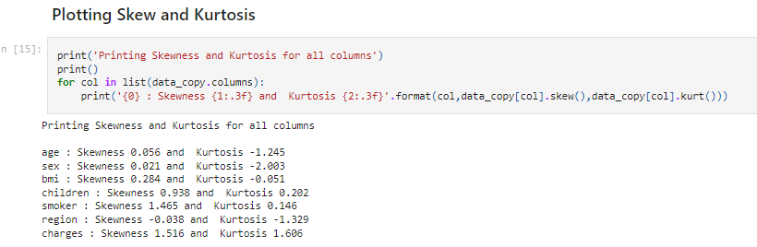
Skew and Kurtosis
Skewness and kurtosis are statistical measures used to assess the shape and distribution of a dataset.
Skewness quantifies the symmetry of a distribution. Skewness measures how much a distribution deviates from perfect symmetry. Positive skewness indicates a longer or fatter tail on the right side, while negative skewness indicates a longer or fatter tail on the left side.
Kurtosis measures the heaviness of the tails in a distribution compared to the normal distribution. It indicates whether a dataset has extreme outliers or is concentrated around the mean. High kurtosis suggests heavy tails and a higher likelihood of outliers, while low kurtosis suggests lighter tails and a lower likelihood of outliers.
In summary, skewness quantifies the lack of symmetry in a dataset, while kurtosis measures the tail heaviness compared to a normal distribution.

Slide 15
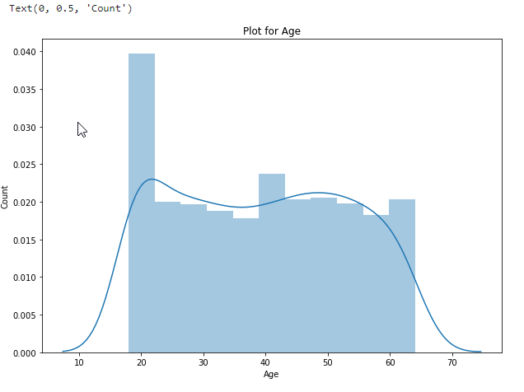
Skew and Kurtosis
The skew value of the age plot is 0.056, and the kurtosis value is −1.245 as shown in Figure below.

Slide 16
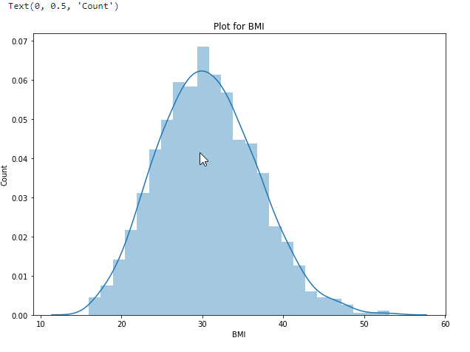
According to BMI, 0.284 and −0.051 are the skew and kurtosis values of BMI, respectively, as shown in Figure below.

Slide 17
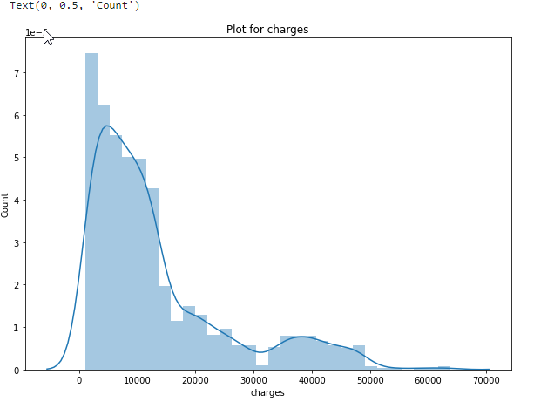
charges : Skewness 1.516 and Kurtosis 1.606

Slide 18
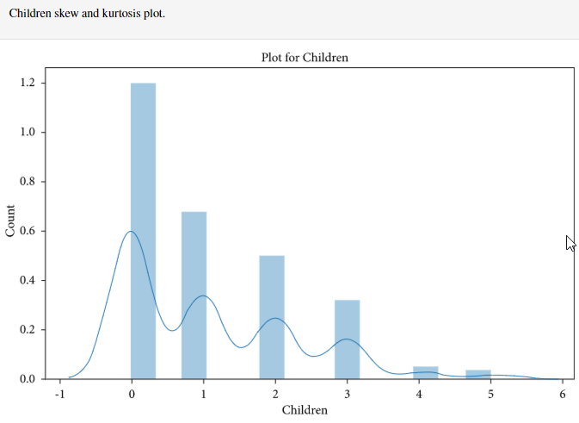
For children, 0.938 and 0.2020 are the skewness and kurtosis values of children, as shown in Figure below.

Slide 19
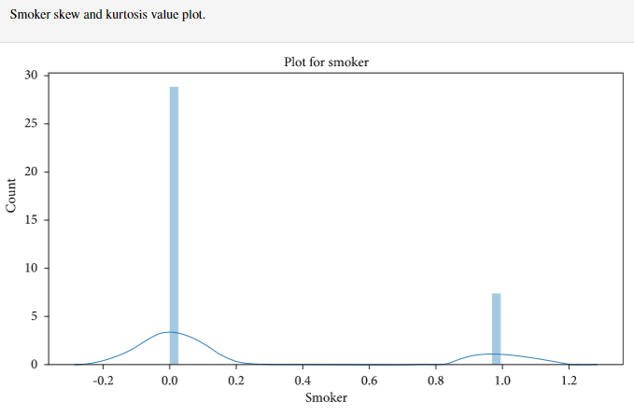
In case of smokers, 1.465 and 0.146 are the skewness and kurtosis values of smokers as shown in Figure below.

Slide 20
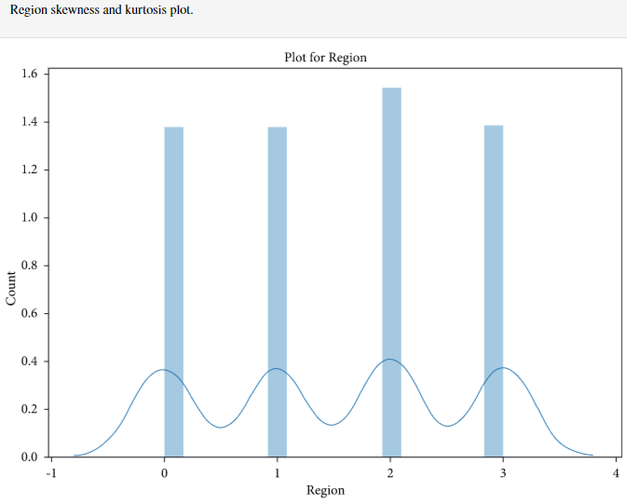
Considering region, −0.038 and −1.329 are the skew and kurtosis values of region, respectively, as shown in Figure below.
There might be few outliers in Charges but then we cannot say that the value is an outlier as there might be cases in which Charge for medical was very less actually!

Slide 21
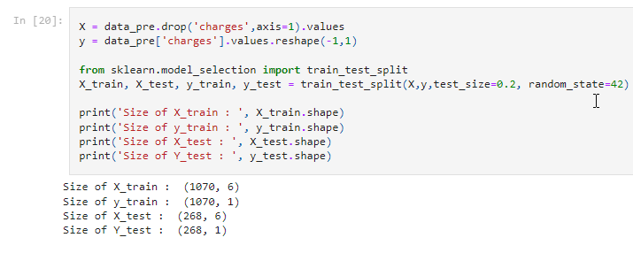
Prepare data for train and test:

Slide 22
1. Linear Regression:
In linear regression, the target variable(Y) is dependent on a single independent variable(X) and the model establishes a linear relationship among these two variables.
The equation of the line is given by:
Y = a + bX
2.Support Vector Machine (Regression)
Support Vector Machine (SVM) Regression is a machine learning algorithm for regression tasks. It finds a hyperplane that best fits the data, maximizing the margin between the hyperplane and the data points. SVM regression uses support vectors to determine the hyperplane and can handle linear and nonlinear relationships.
3.Ridge Regression:
Ridge regression is a variant of linear regression that addresses the issue of multicollinearity (high correlation between predictor variables) and helps prevent overfitting. ridge regression strikes a balance between simplicity and flexibility, providing a more robust and stable regression model.
4. Random Forest Regressor
Random Forest Regressor is a machine learning algorithm that belongs to the ensemble learning family. It combines multiple decision trees to make predictions in regression tasks. Each decision tree is built on a randomly selected subset of features and trained on different subsets of the training data.

Slide 23
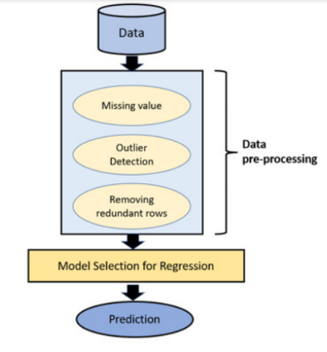
Flowchart of MLHIPS Model

Slide 24
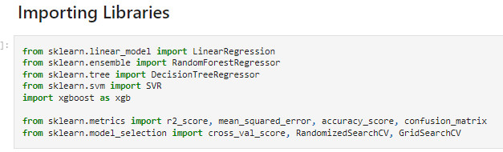
This code snippet imports various modules and classes from scikit-learn and XGBoost, along with specific functions and classes for model evaluation and hyperparameter tuning.

Slide 25
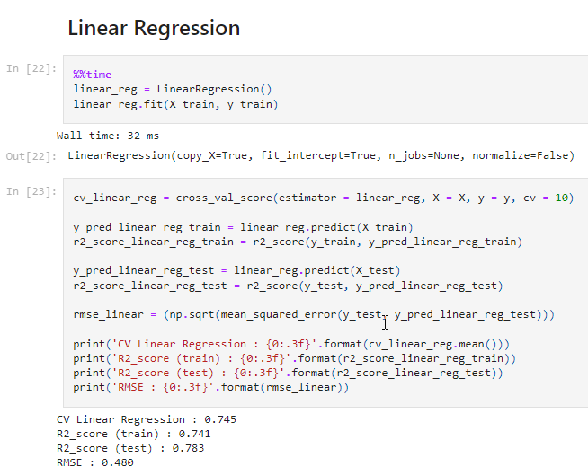
Linear Regression:
In linear regression, the target variable(Y) is dependent on a single independent variable(X) and the model establishes a linear relationship among these two variables.
The equation of the line is given by:
Y = a + bX

Slide 26
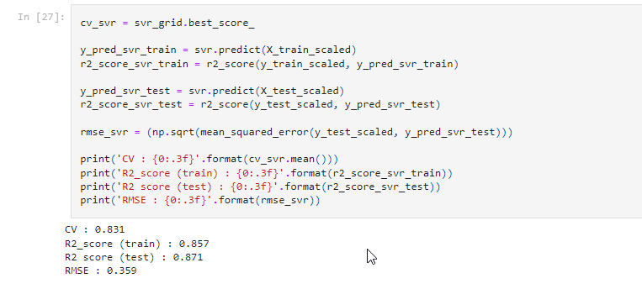
Support Vector Machine (Regression):
Support Vector Machine (SVM) Regression is a machine learning algorithm for regression tasks. It finds a hyperplane that best fits the data, maximizing the margin between the hyperplane and the data points. SVM regression uses support vectors to determine the hyperplane and can handle linear and nonlinear relationships.

Slide 27
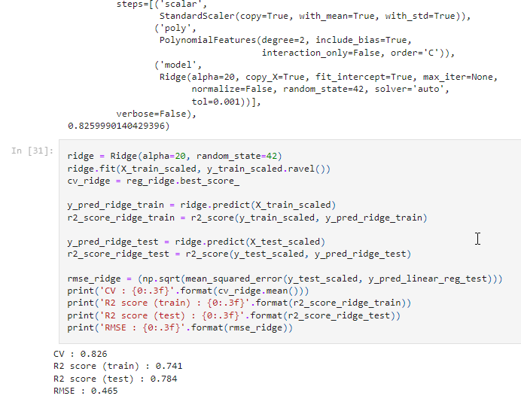
Ridge Regression:
Ridge regression is a variant of linear regression that addresses the issue of multicollinearity (high correlation between predictor variables) and helps prevent overfitting. ridge regression strikes a balance between simplicity and flexibility, providing a more robust and stable regression model.

Slide 28
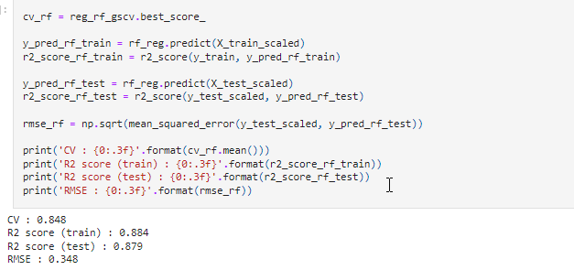
Random Forest Regressor:
Random Forest Regressor is a machine learning algorithm that belongs to the ensemble learning family. It combines multiple decision trees to make predictions in regression tasks. Each decision tree is built on a randomly selected subset of features and trained on different subsets of the training data.

Slide 29
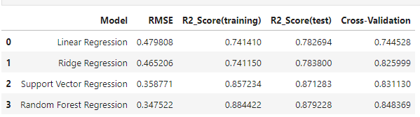
The objective of this study was to predict the price of medical insurance. We used various regression techniques like Linear Regression, Ridge Regression, Random forest, and Support Vector Machine (Regression) For this experiment, we recommend that one should use a machine with at least 16GB RAM and generation of Intel Processor shall be at-least 9th technology or above. Dataset was split into 2 sets, one set for training and one for testing purposes. We used python programming for noting the results of carried-out techniques on test and training datasets.

Slide 30
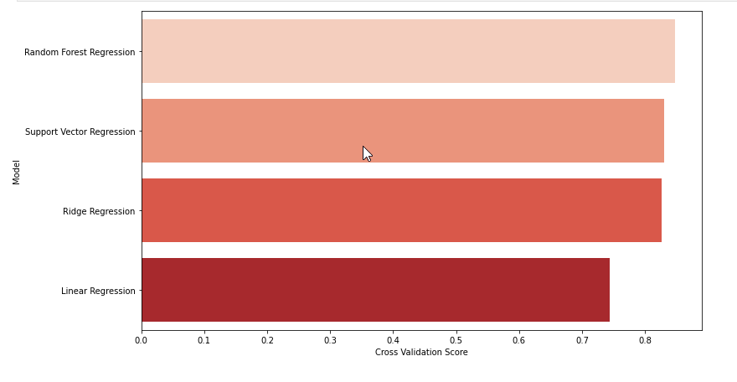
Using matplotlib and seaborn libraries to create a bar plot visualization of the cross-validation scores for different models.

Slide 31
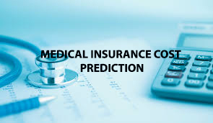
summary
Among the models tested, Ridge Regression and Support Vector Machine obtained accuracies of 75.82% and 75.86% respectively, while ,Simple Linear Regression had the lowest accuracy of 62.86%. The dataset was split into an 80-20 ratio for training and testing.
CONCLUSION :
Model gave 86% accuracy for Medical Insurance Amount Prediction using Random Forest Regressor.

Slide 32
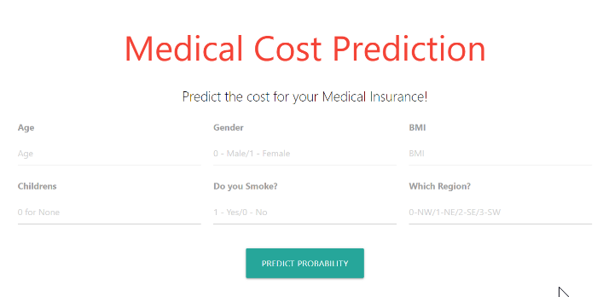
FUTURE WORK
will make an application using flask that will look like this:

Slide 33
Thank you

